Slide 1

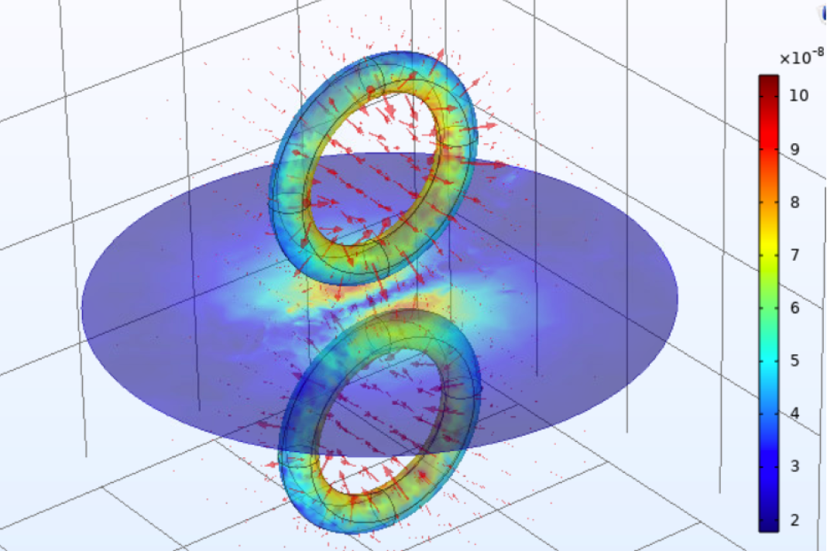
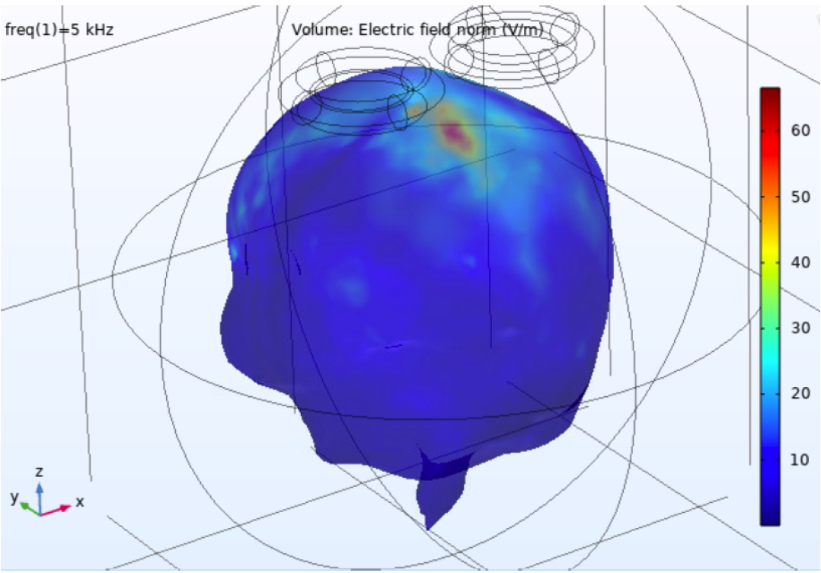
自我介紹一覽
相關專案：
(論文)Deep Learning-based Multiclass Segmentation and 3D Reconstruction for Modelling Transcranial Stimulation.
Computational Modelling of Transcranial Magnetic Stimulation Used in Major Depressive Disorder Treatment
謝銘偉(Ming-Wei, Hsieh)
學經歷：
生醫工程碩士 - 澳洲新南威爾士大學 (2020 – 2023)
Master of Engineering Science, Specialise in Biomedical Engineering
測試工程師 - 京元電子(KYEC) (2015 – 2019)
電機工程系學士 - 東海大學 (2011 – 2015)
技能：
程式語言：Python, MATLAB
機器學習
生醫訊號/影像處理

Slide 2
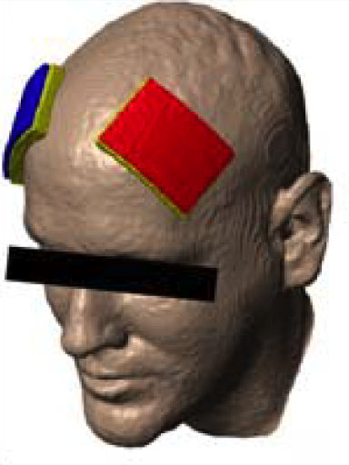
經顱刺激(Transcranial Stimulation)
臨床研究包含憂鬱症、急慢性疼痛、復健、成癮行為、神經心理疾病方面研究
經顱直流電刺激 Transcranial direct current stimulation (tDCS)
(重複)經顱磁刺激 (repetitive)Transcranial magnetic stimulation(rTMS)

Slide 3
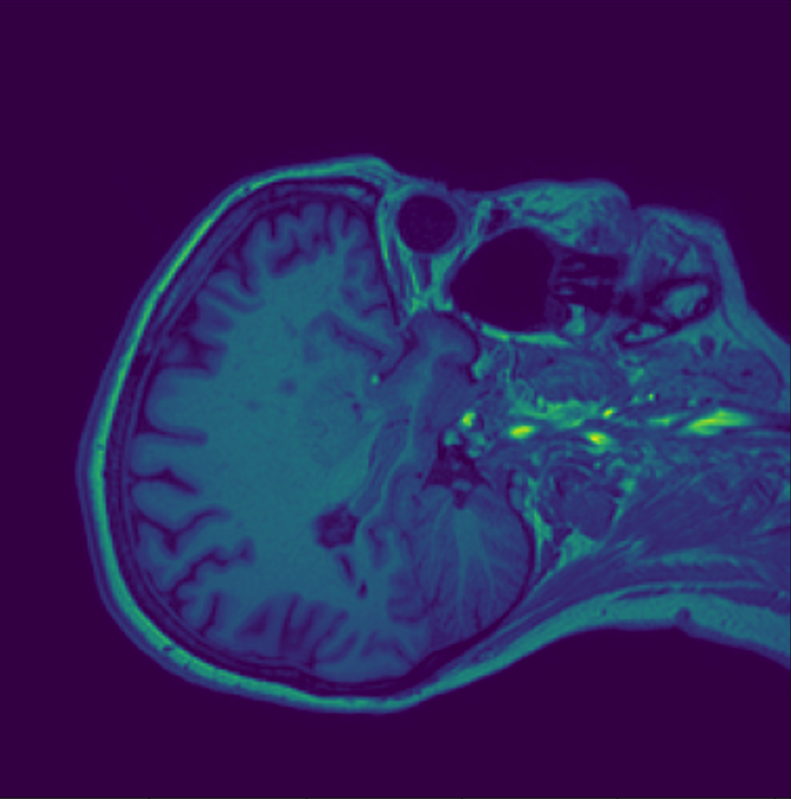
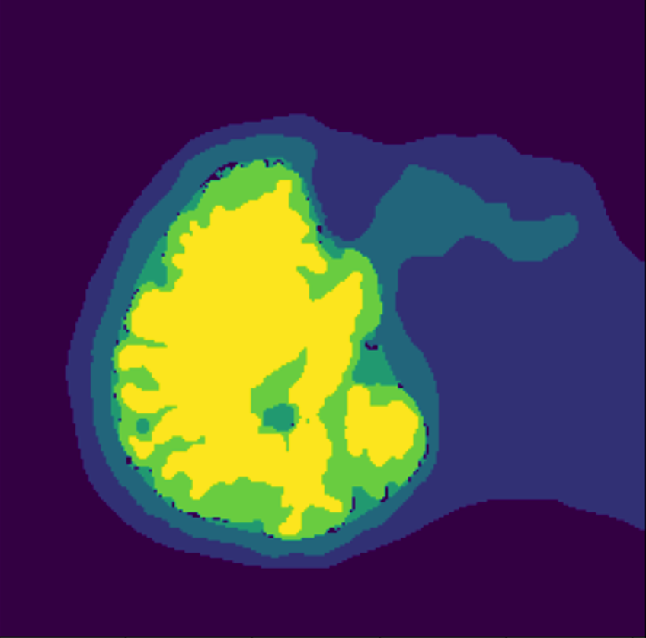
一個有限模型的誕生
MRI 語義分割
根據標記產出
有限網格(FEM)模型
產出模型進行模擬
MRI

Slide 4
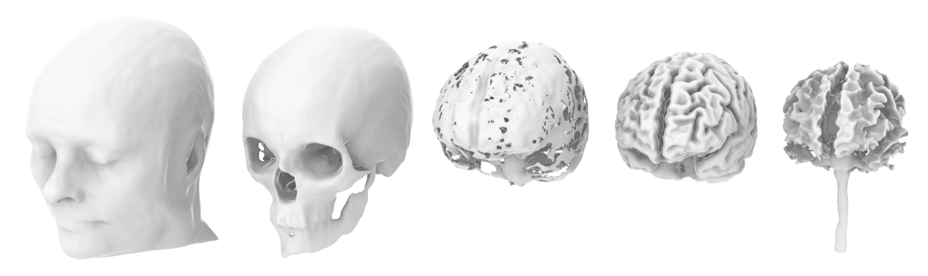
標記種類
1:皮膚(含皮下組織)
2:顱骨
3:脊髓液
4:灰質
5:白質

Slide 5
3D-Unet
Encoder
Decoder

Slide 6

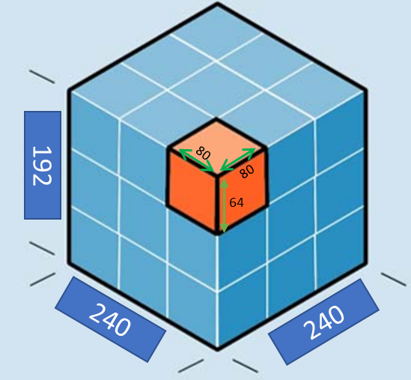
訓練資料
MRI Files Size (240,240,192) pixels
訓練集
(Training Set)
驗證集
(Validation Set)
測試集
(Test Set)
1
2
3
4
5
6
7
Slice on 5 segments from each axis of an MRI file
=125 volumes +
Randomly Slice 25 sub-volumes and ensure each contains brain(CSF+GM+WM) volume > 80%
Slice on 5 segments from each axis of an MRI file =125 volumes
*Augment brain contained data on training and validation set
Sub-Volume
Size (80,80,64) pixels
750x 子體積
150x 子體積
125x 子體積
DataSize(Number, Class, Length, Width, Height) | Training Set | Validation Set
Image(Volume) | (750, 1, 80, 80, 64) | (150, 1, 80, 80, 64)
Label | (750, 5, 80, 80, 64) | (150, 5, 80, 80, 64)
*The data set being used for prediction and hasn’t been seen by the Network
Network
Input

Slide 7
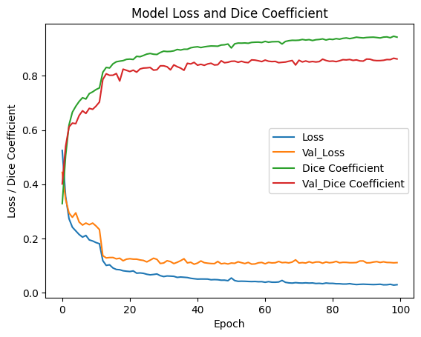
訓練結果(100 epoch)
訓練集 Loss: 0.029
訓練集 Dice Coefficient:0.9427
驗證集 Loss:0.1105
驗證集 Dice Coefficient: 0.8622
Optimizer = Adam
Loss Function = Soft Dice Lost
Metric = Dice coefficient
Learning Rate= 0.00001
Batch Size = 1(According to GPU memory limit)
Epoch = 100
Steps per epoch = 750
Validation Steps per epoch = 150
Training Time per epoch: ~860secs/ ~15mins
Total Training Time: 1429m ~24hrs
*Network overfitting on training set:
At 50 epoch, the accuracy(Dice Coefficient) reached 90% on the training set and 85% on validation set. However, in subsequent epochs, the accuracy on the validation set only slightly improved to 86%, while the accuracy on the training set improved from 90% to 94%. This suggests that the network was overfitting to the training set and was unable to improve its predictive capabilities on the validation set.

Slide 8
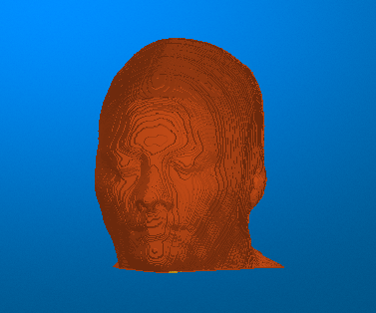
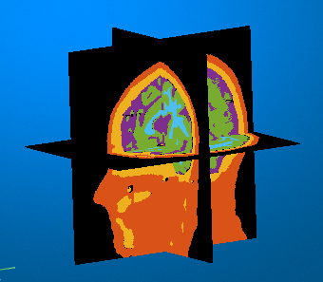
預測子體積, 重建頭顱3D圖像

Slide 9
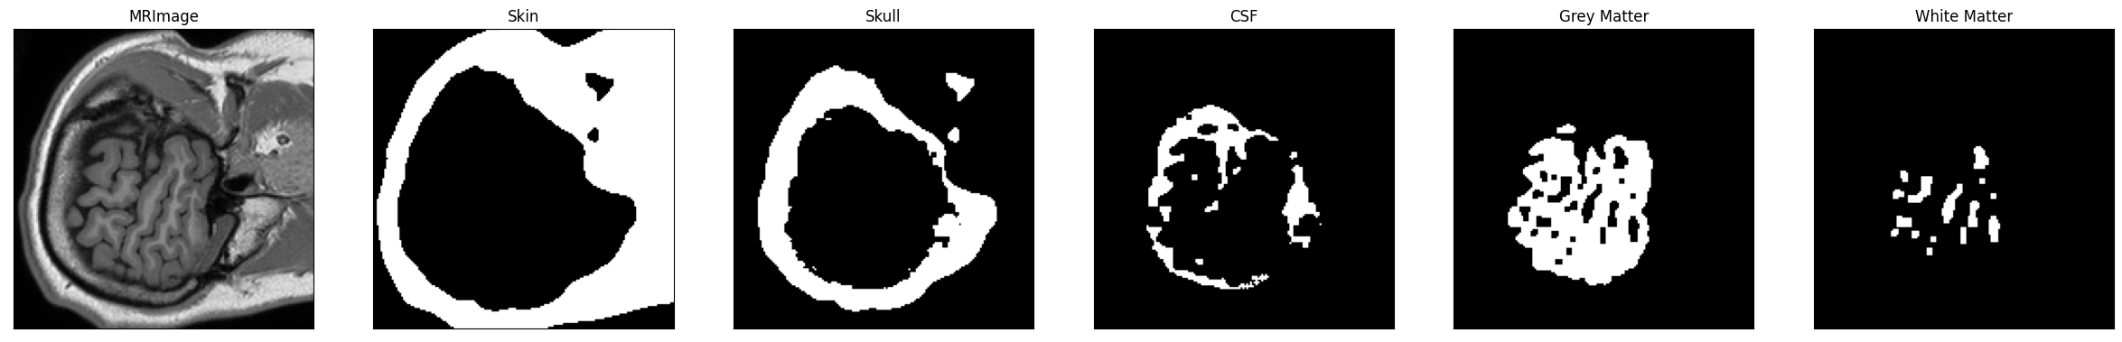
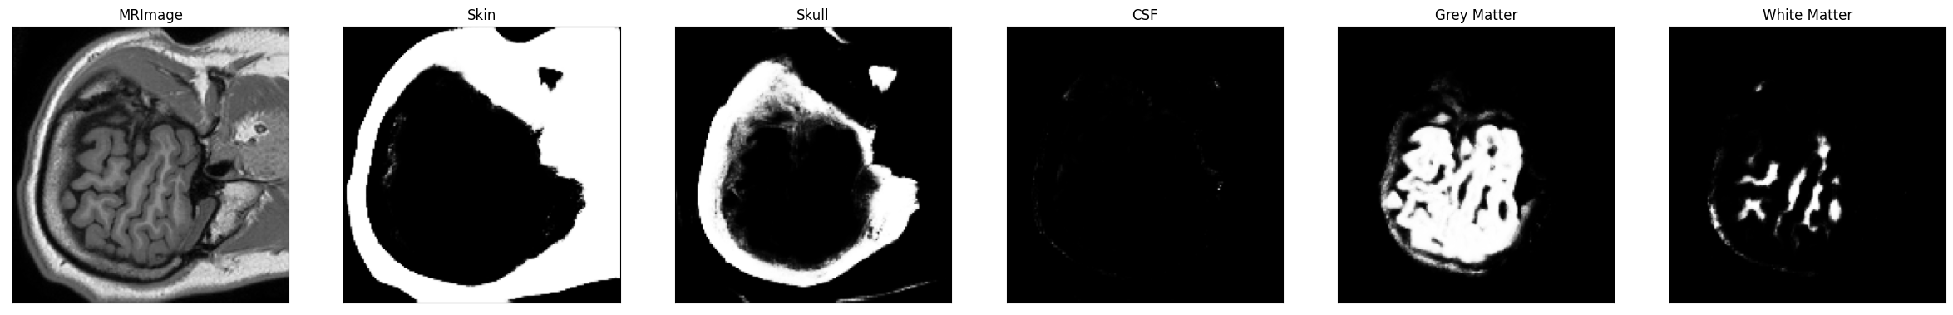
初次模型預測結果
真實標記 子體積(160, 160, 16)
預測標記 子體積(160, 160, 16)

Slide 10
影像預處理：修復缺失標記
3x3 scanning window scans on each pixel by (row, col)
 | 0
缺失標記的像素以其像素值(pixel intensity)來判定該值是偏向1.脊髓液2.灰質3.顱骨

Slide 11
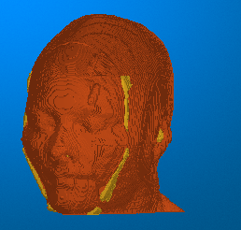
Predict, Reconstruct, then View in 3D
Reconstruct with 27 sub-volumes
Reconstruct with 125 sub-volumes
: Skin
: Skull

Slide 12
重建方法
Previous: Reconstruct with 27 sub-volumes
Improvement: Reconstruct with 125 sub-volumes
*Remove some(20) pixels near the edge to avoid edge defects. Replace with another sub-volume part.
*Defects on the sub-volume edge.
Two additional sub-volumes required to replace the edge defects on each axis

Slide 13
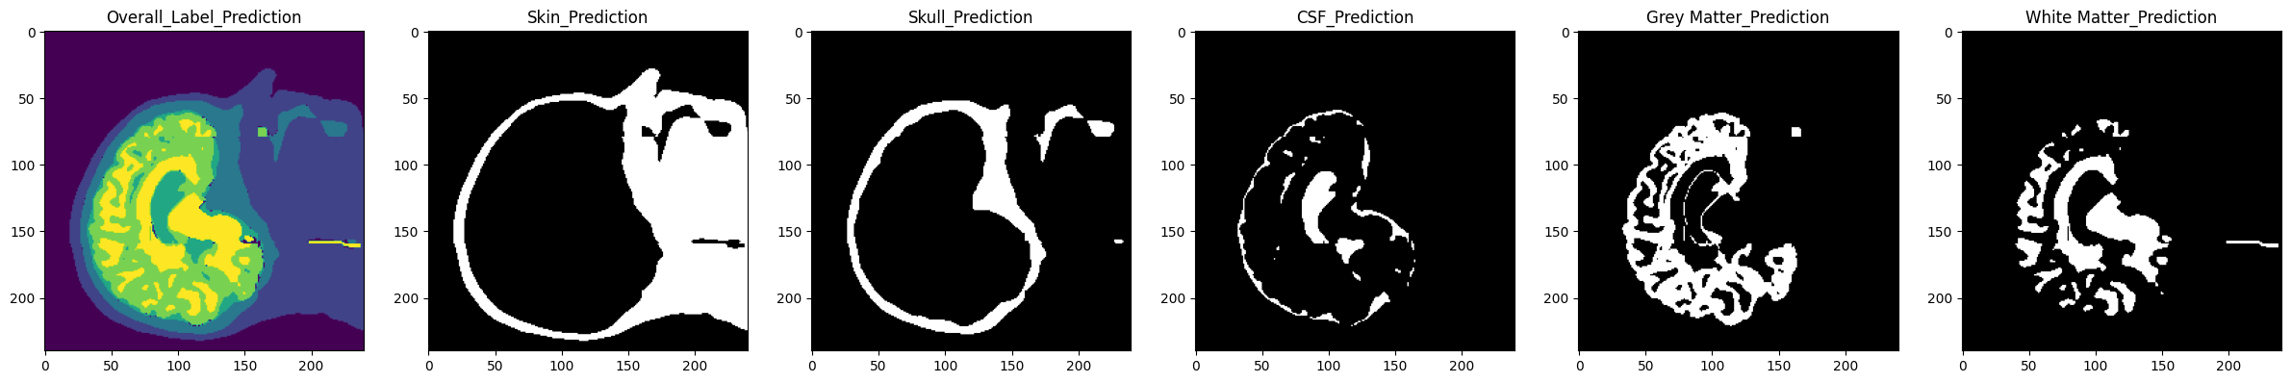
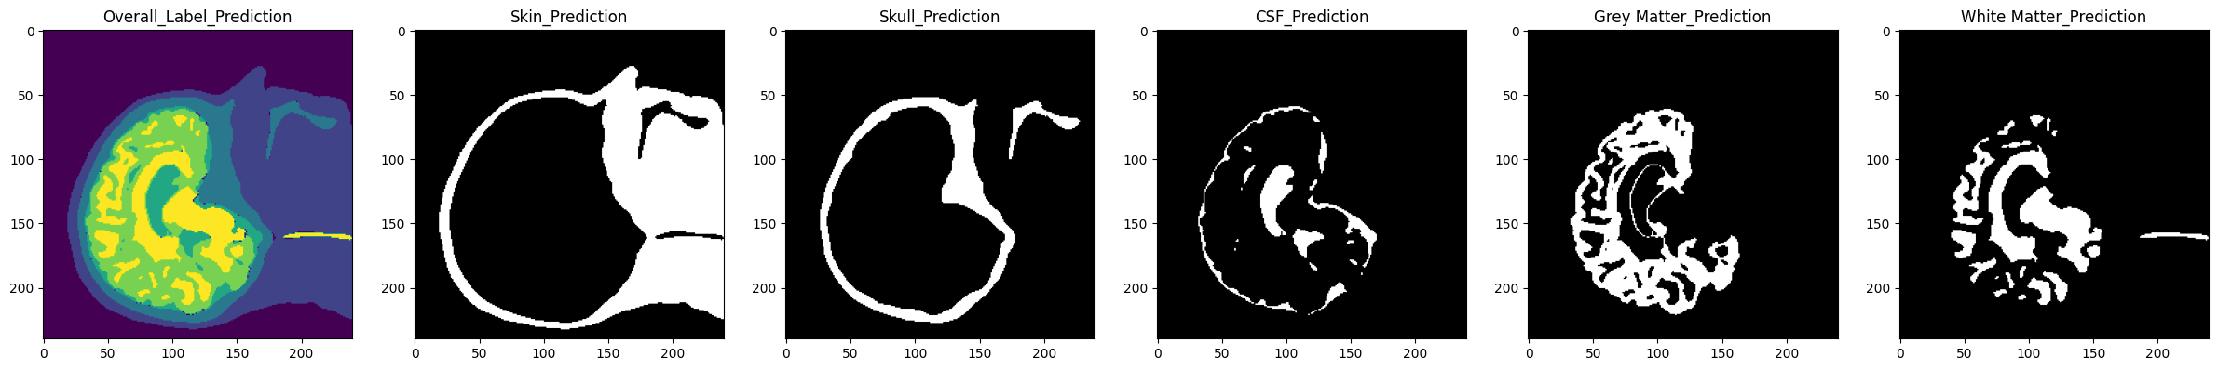
Reconstruct Methods Makes the difference
Reconstruct with 27 sub-volumes: Overall and Prediction by tissue (index 90 slice on Sagittal_xy Plane)
*Defects on the sub-volume edge.
Reconstruct with 125 sub-volumes: Overall and Prediction by tissue (index 90 slice on Sagittal_xy Plane)
Overall(Mean)IoU= 0.683
Skin IoU= 0.9407
Skull IoU= 0.8222
CSF IoU= 0.7210
GM IoU= 0.7293
WM IoU= 0.7778
Overall(Mean)IoU= 0.6945
Skin IoU= 0.9447
Skull IoU= 0.8346
CSF IoU= 0.7316
GM IoU= 0.7332
WM IoU= 0.7817

Slide 14
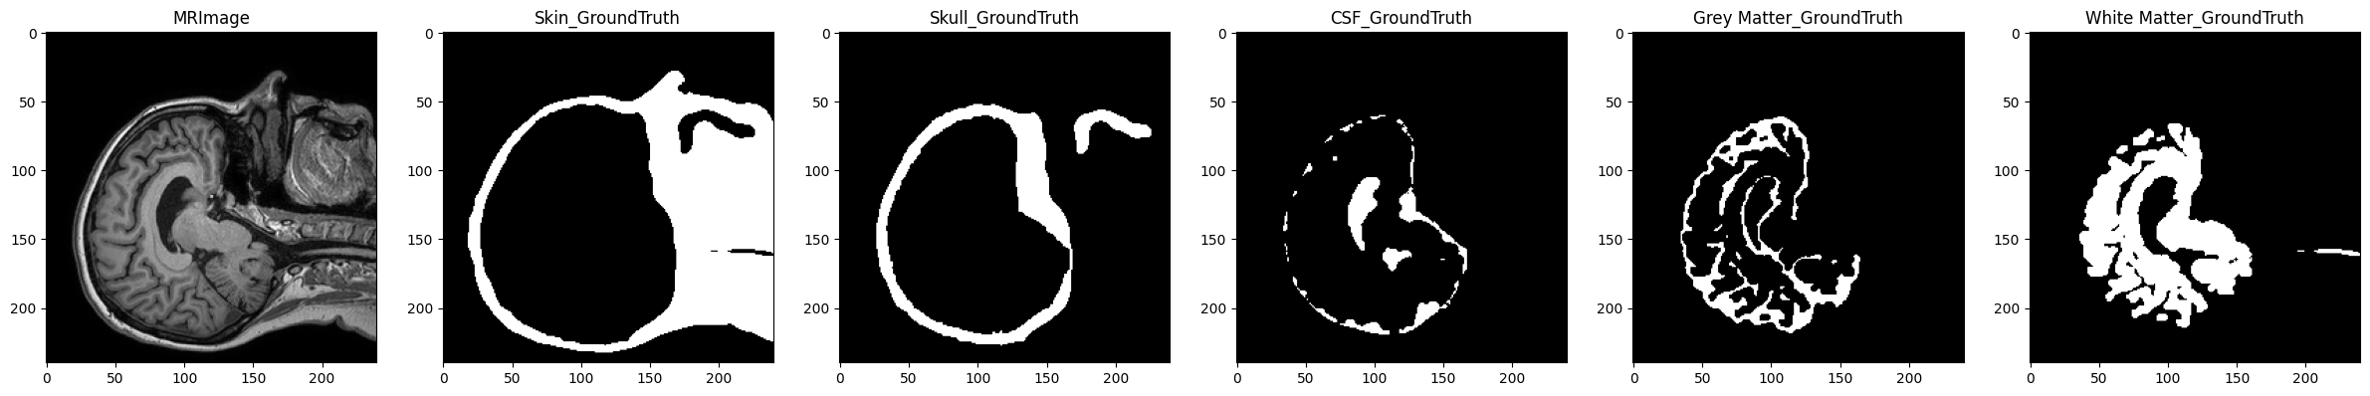

MRI and Ground Truth by tissue (index 90 slice on Sagittal_xy Plane)
Ground Truth
Dice Loss
Overall(Mean)IoU= 0.683
Skin IoU= 0.9407
Skull IoU= 0.8222
CSF IoU= 0.7210
GM IoU= 0.7293
WM IoU= 0.7778
Focal Loss + Dice Loss
Overall(Mean)IoU= 0.7042
Skin IoU= 0.9399
Skull IoU= 0.8296
CSF IoU= 0.7428
GM IoU= 0.7457
WM IoU= 0.7995

Slide 15
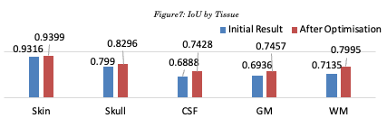
訓練結果比較一覽
改善方法：
子體積修正
修補缺失label
修刪UNET層數減少過擬合
優化重建方法
數據擴增
DiceLoss 改成
Focal Loss + Dice Loss
Structure | Mean IoU | F.W.IoU
1. 4-layer-UNET | 0.5503 | 0.6725
2. 4-layer-UNET w/ D.A. | 0.6347 | 0.7393
3. 4-layer-UNET w/ D.A. & total loss | 0.6467 | 0.7442
4. 5-layer-UNET w/ D.A. & total loss | 0.6446 | 0.7450

Slide 16
Class Over/Under-prediction : A Disadvantage of UNET
Ground Truth
Total Loss
Overall(Mean)IoU= 0.7042
Skin IoU= 0.9399
Skull IoU= 0.8296
CSF IoU= 0.7428
GM IoU= 0.7457
WM IoU= 0.7995
 | Skin | Skull | CSF | GM | WM
Precision | 0.963 | 0.795 | 0.694 | 0.577 | 0.954
Recall | 0.933 | 0.827 | 0.644 | 0.855 | 0.644
F1 Score | 0.947 | 0.811 | 0.668 | 0.689 | 0.769

Slide 17
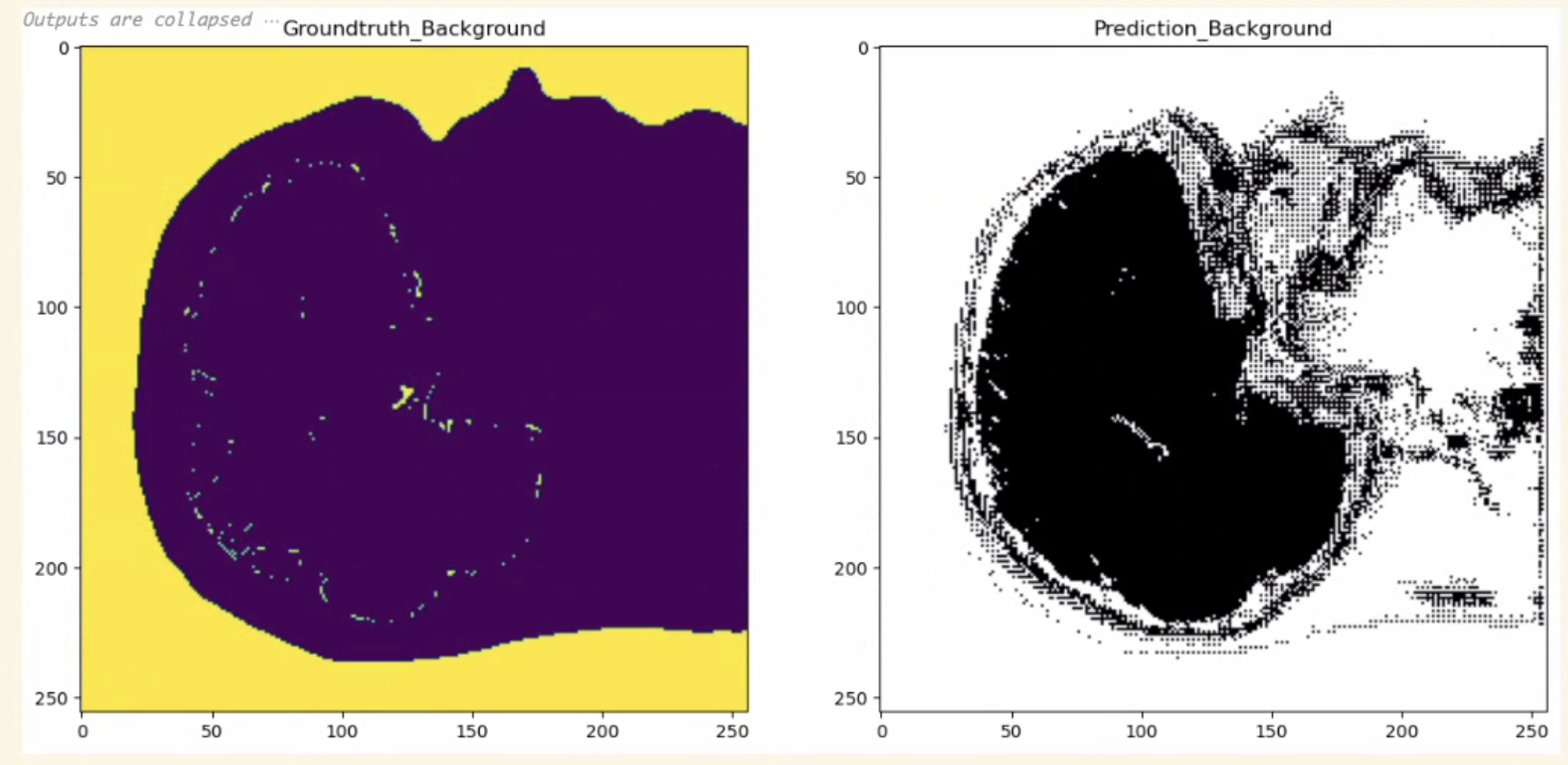
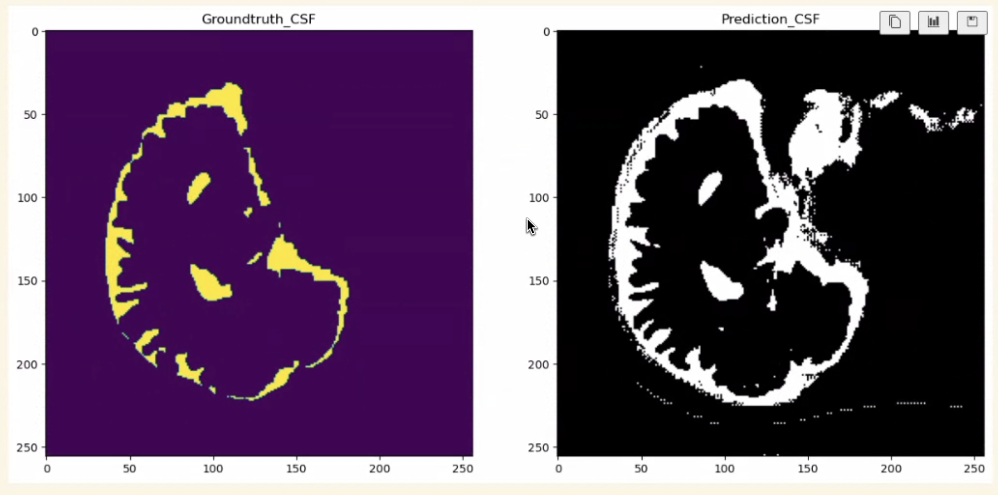
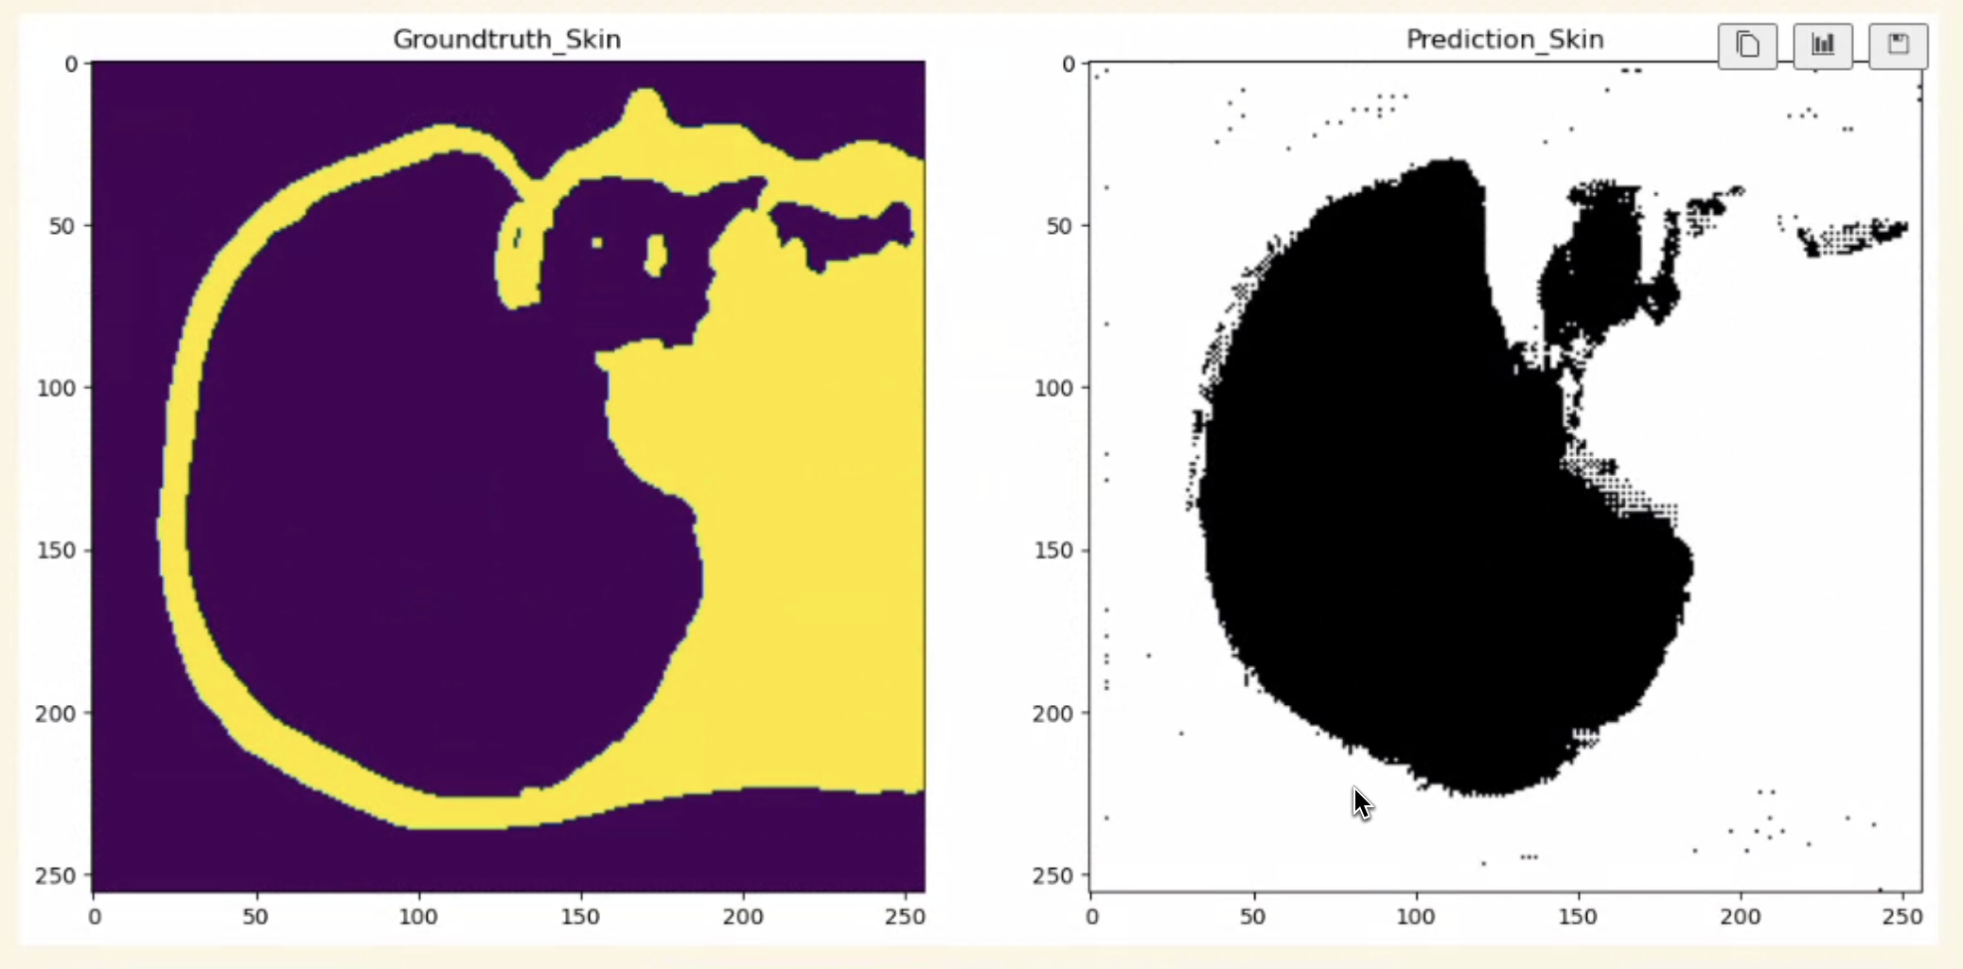
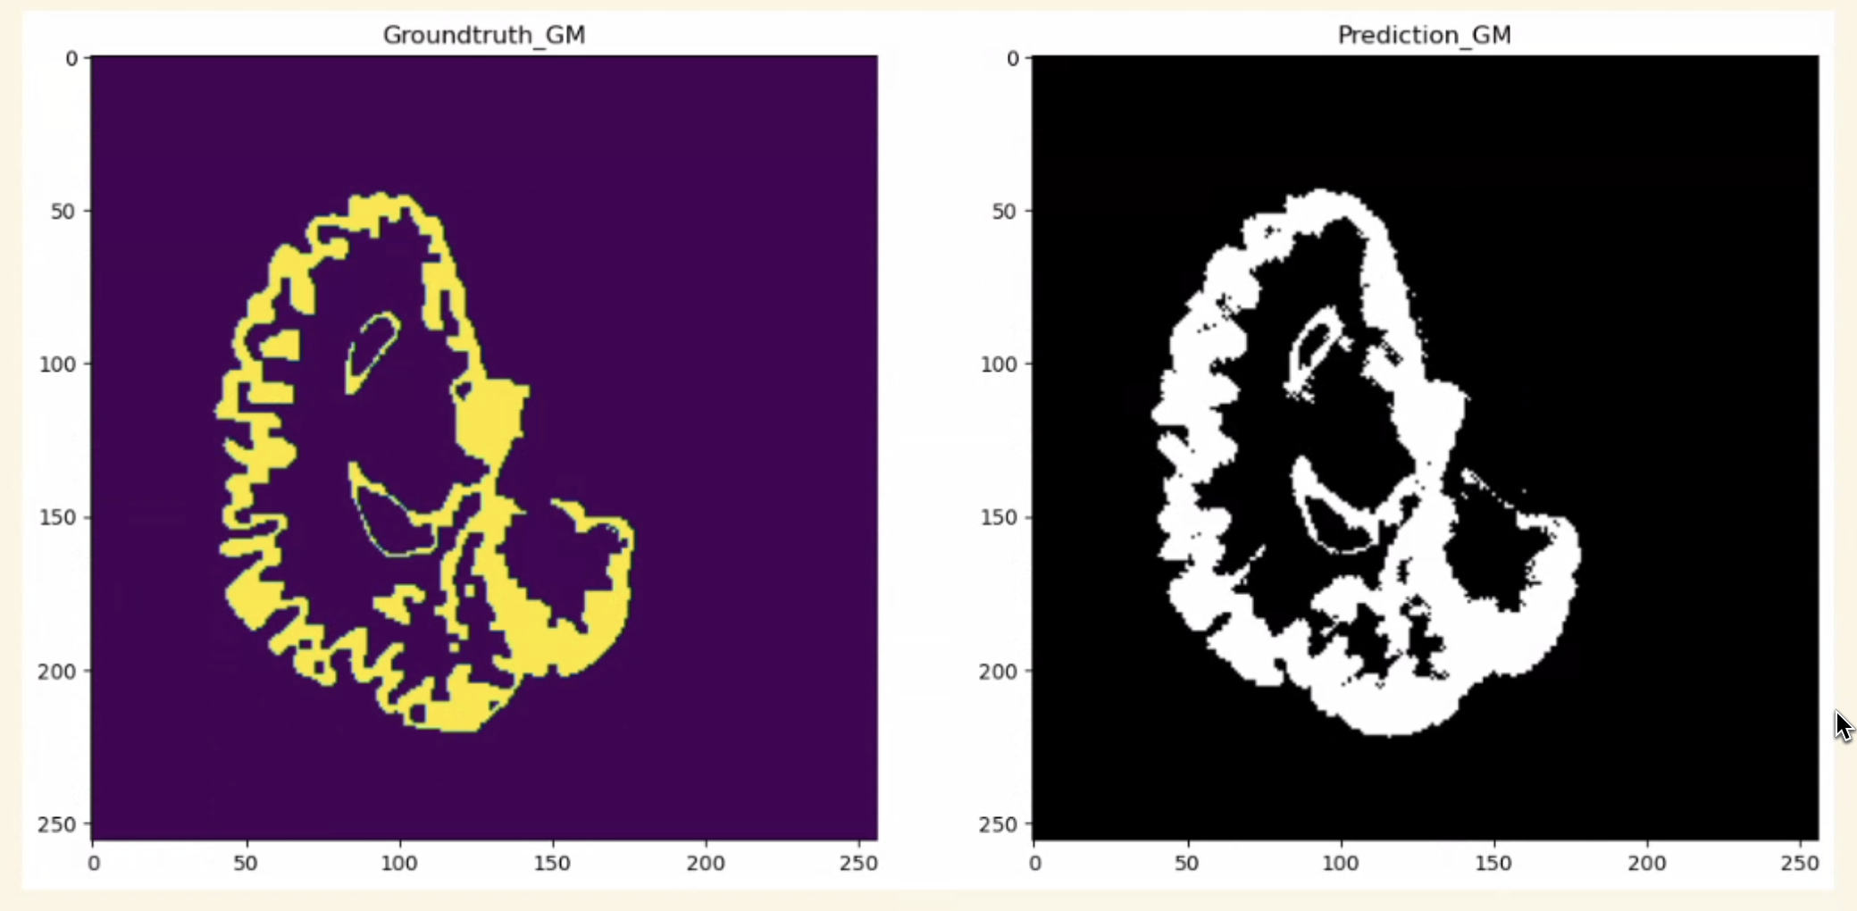
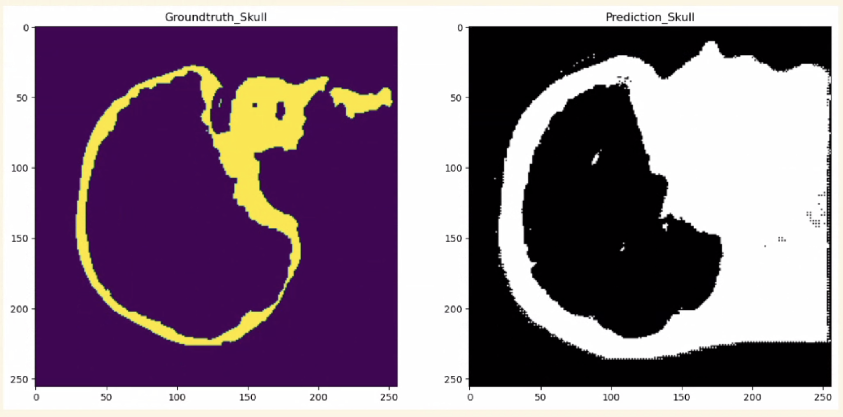
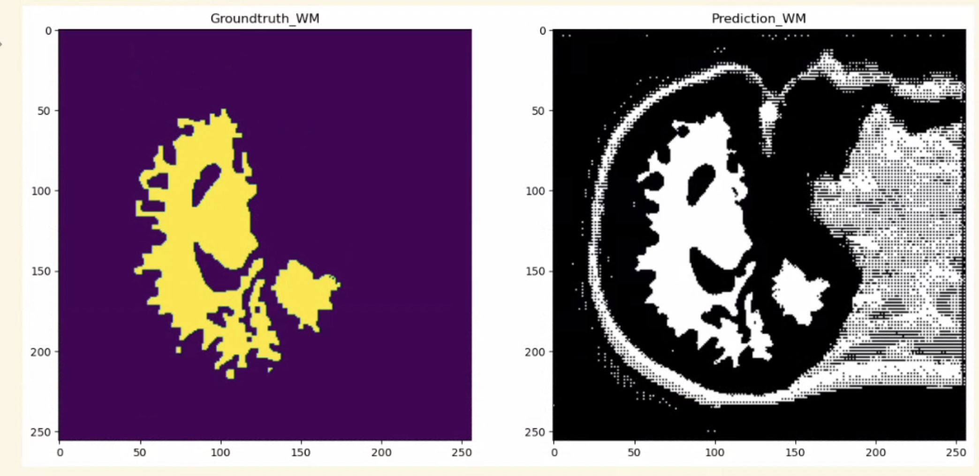
2D U-net Result

Slide 18
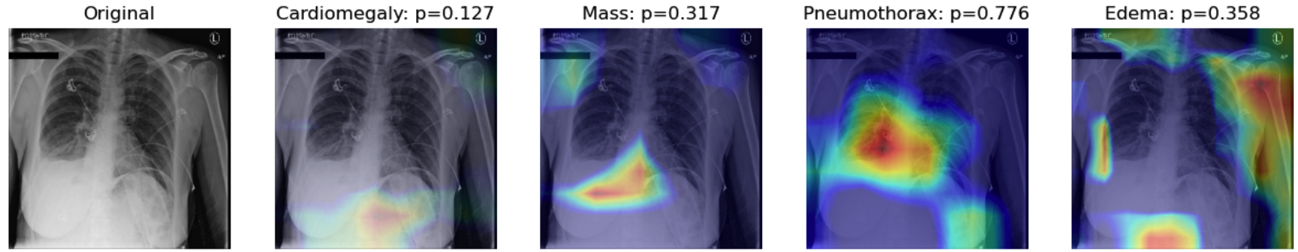
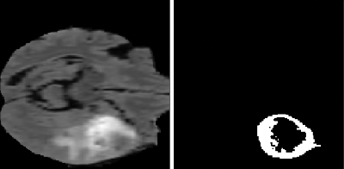
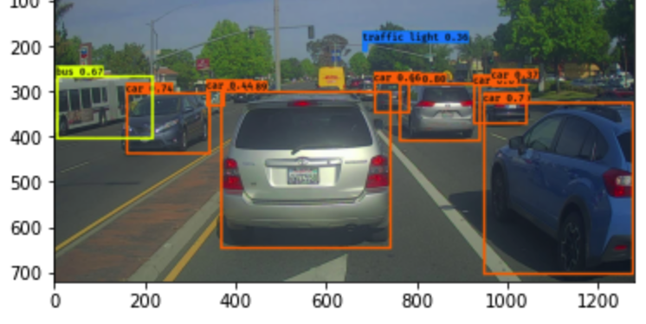
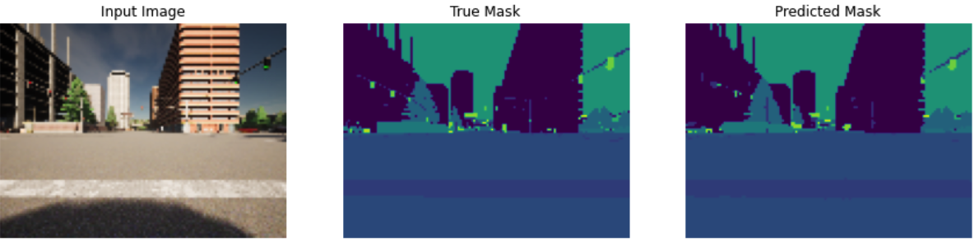
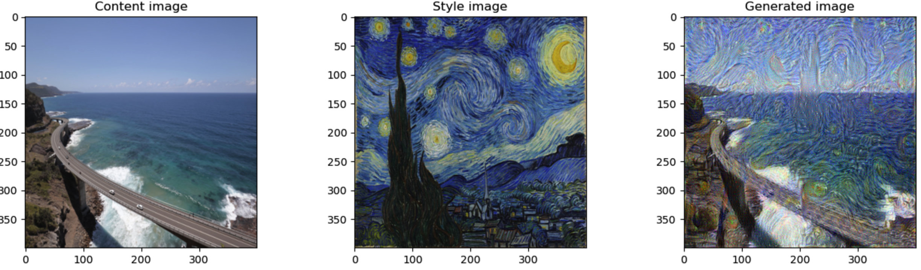
Machine Learning Practices
Topic | Category | Network/Algorithm | Pre-trained | Overview
Chest X-Ray Classification with Gradcam | Image Classification | DenseNet21 | Yes
Brain Tumour Segmentation | Image Segmentation | UNET(3D-Conv) | Yes
Extracting Ground Truth Labels from Radiology Reports | NLP | Bert/Fine Tuning | Yes
Risk Models Using Tree-based Models | Classification | RandomForests/C-Index | No
Car Detection | Image Classification | Yolo | Yes
Street view Segmentation | Image Segmentation | UNET(2D-Conv) | No
Art Generation | Generative | VGG-19/ Neural Style Transfer | Yes

